Slide 1
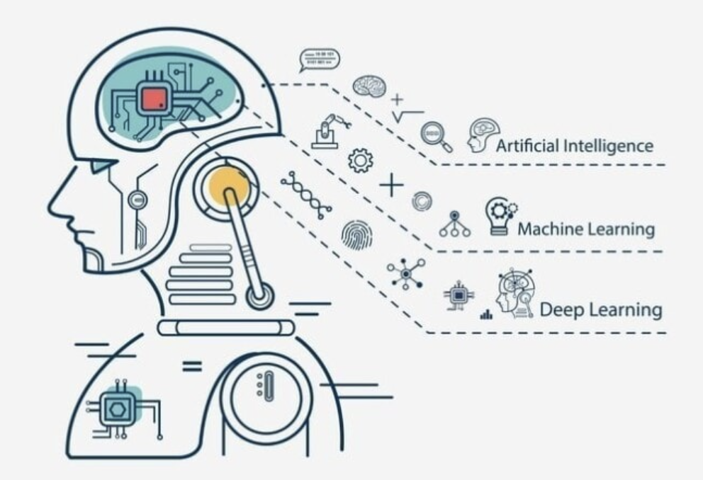


AI and Complex Systems
张江
北京师范大学系统科学学院教授
集智俱乐部、集智学园创始人
集智研究中心理事长
北师大系统科学学院：面向复杂系统的人工智能，2024
Notes:
封面

Slide 2
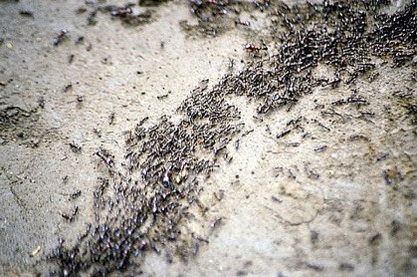
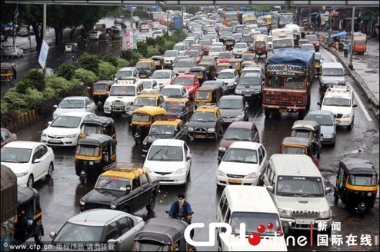

What are Complex Systems?
北师大系统科学学院：面向复杂系统的人工智能，2024

Slide 3
What are Complex Systems?
简单系统
复杂系统
无组织的随机系统
北师大系统科学学院：面向复杂系统的人工智能，2024

Slide 4
What is complexity science?
北师大系统科学学院：面向复杂系统的人工智能，2024

Slide 5
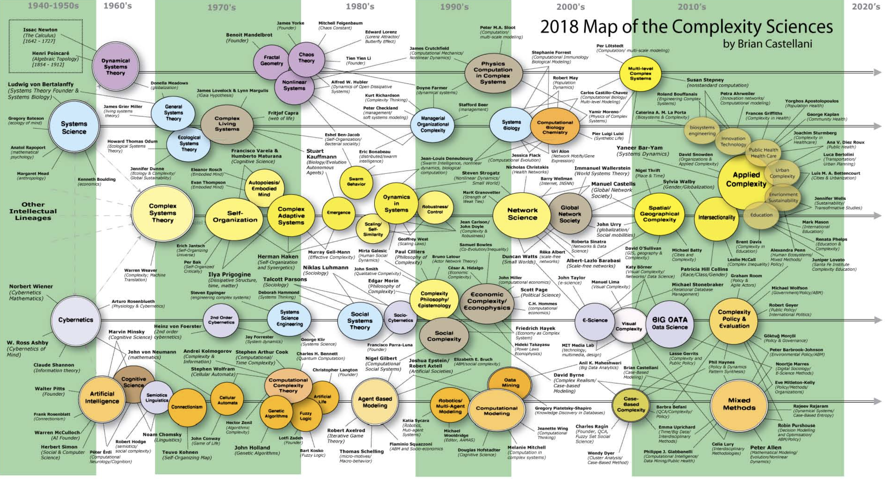
What is complexity science?
北师大系统科学学院：面向复杂系统的人工智能，2024

Slide 6

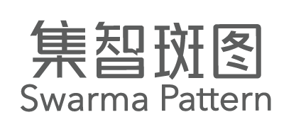
（复杂）系统科学的演进
老三论
新三论
圣塔菲学派
复杂网络
数据驱动
AI？
大模型？
1930-1960
1970-1990
1990-2000
2000-2010
2010-2020
？
系统论
信息论
控制论
耗散结构论
协同学
突变论
多主体建模
人工生命
元胞自动机
布尔网络
……
ER随机网：图论+统计
复杂网络：小世界、无标度（图论+统计物理）
网络科学
复杂系统物理学
Scaling
计算社会科学
……
分形
混沌
更多“人工智能 & 复杂系统”的知识，请关注官网：campus.swarma.org

Slide 7
What is complexity science?
北师大系统科学学院：面向复杂系统的人工智能，2024

Slide 8
What is complexity science?
系统工程
系统科学
物理学
复杂科学
社会/经济
生物/生态学
数学
哲学
人工智能/计算机科学
北师大系统科学学院：面向复杂系统的人工智能，2024

Slide 9
New AI – Big Data AI
北师大系统科学学院：面向复杂系统的人工智能，2024

Slide 10

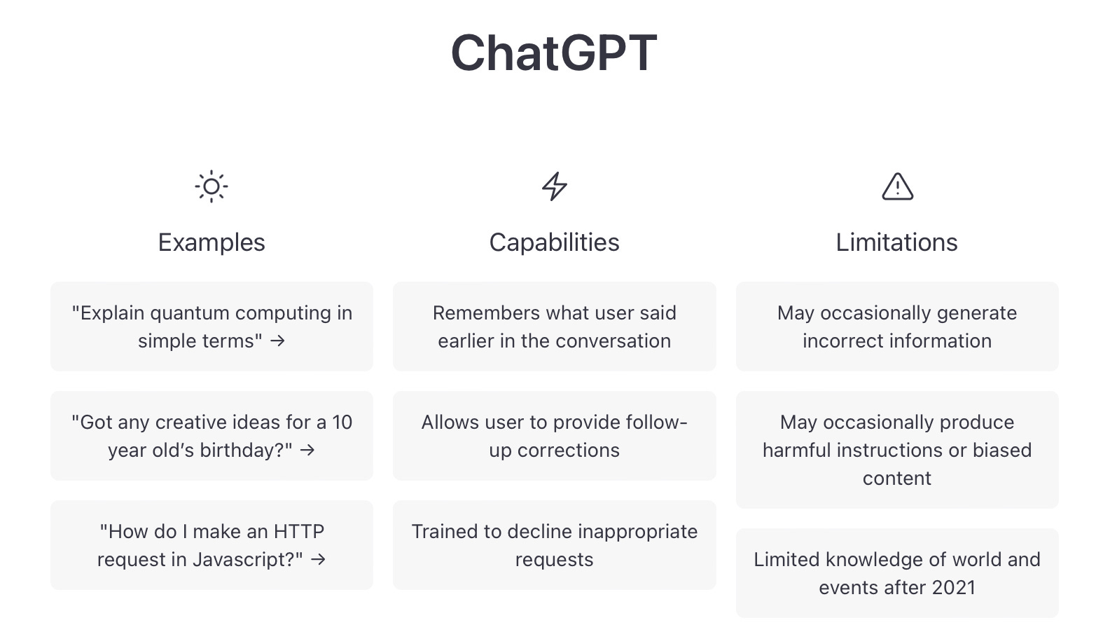

Hot ChatGPT
更多“人工智能 & 复杂系统”的知识，请关注官网：campus.swarma.org

Slide 11
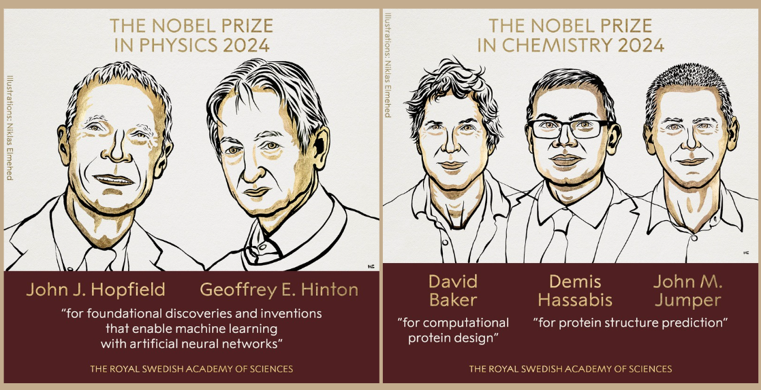
Hot ChatGPT
北师大系统科学学院：面向复杂系统的人工智能，2024

Slide 12
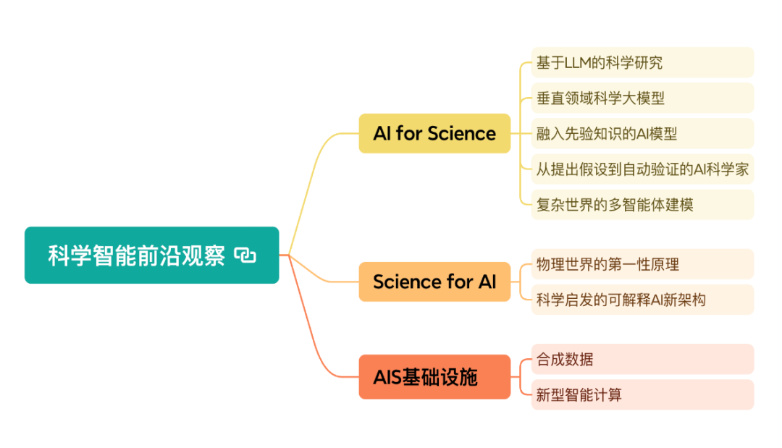
AI & Science
北师大系统科学学院：面向复杂系统的人工智能，2024

Slide 13
Outline
AI for complex systems
Complexity science for AI
北师大系统科学学院：面向复杂系统的人工智能，2024

Slide 14
Outline
AI for complex systems
Complex Systems and Modelling Methods
Representation & Generation
Dynamics Learning
Network Reconstruction
Multi-scale Modelling
Simulation, optimization, and control
Complexity science for AI
北师大系统科学学院：面向复杂系统的人工智能，2024

Slide 15
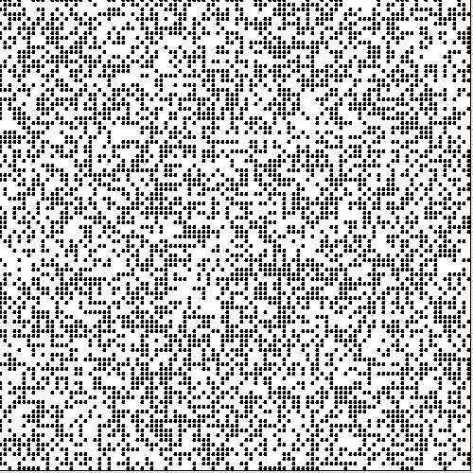
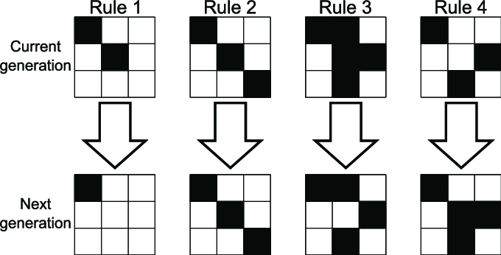
Game of Life
Conway’s GAME of LIFE
Each cell has 8 neighbors
Change color according to neighbors
Studying complexity
北师大系统科学学院：面向复杂系统的人工智能，2024

Slide 16
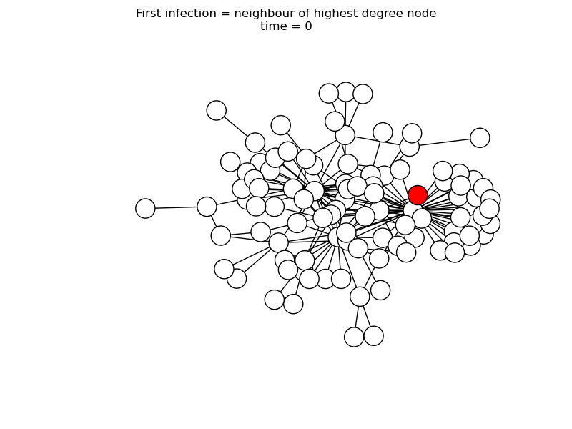
SIR on Network
SIR model
S node (white) can be infected by the infectious node (red)
Infectious node can turn to recovered (grey)
北师大系统科学学院：面向复杂系统的人工智能，2024

Slide 17
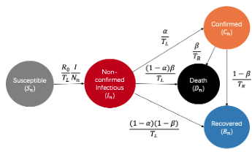
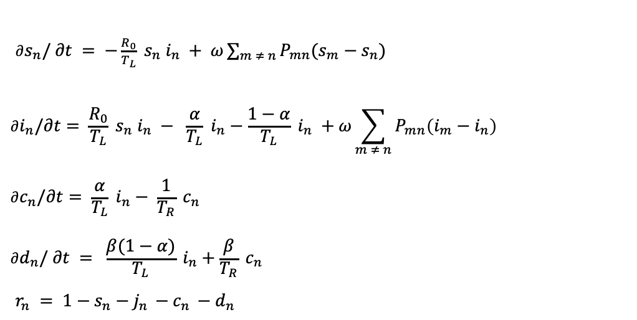
Epidemic
$∂s_{n}/ ∂t = −\frac{R_{0}}{T_{L}} s_{n} i_{n} + ω\sum_{m ≠ n}{P_{mn}(s_{m}−s_{n})}$
$$∂i_{n}/∂t= \frac{R_{0}}{T_{L}} s_{n} i_{n} − \frac{α}{T_{L}} i_{n}−\frac{1−α}{T_{L}} i_{n} +ω\sum_{m ≠ n}{P_{mn}\left(i_{m}−i_{n}\right)}$$
$$∂c_{n}/∂t= \frac{α}{T_{L}} i_{n}− \frac{1}{T_{R}} c_{n}$$
$$∂d_{n}/ ∂t = \frac{β(1−α)}{T_{L}} i_{n}+\frac{β}{T_{R}} c_{n}$$
$r_{n} = 1−s_{n}−j_{n }−c_{n }−d_{n }$
Jiang Zhang,et al. Investigating time, strength, and duration of measures in controlling the spread of COVID-19 using a networked meta-population model; Nonlinear Dynamics 101(10223) (2020)

Slide 18
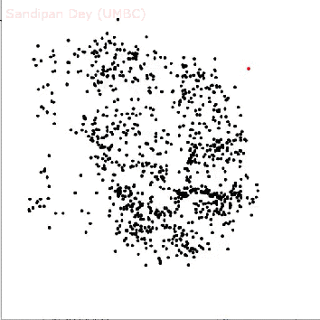
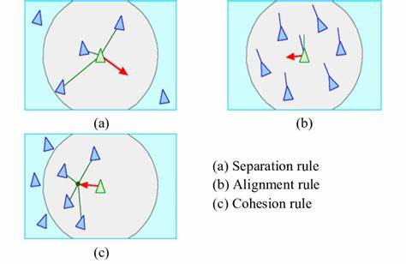
Boid Model
Boid model
Each boid follows 3 rules
Cohesion
Alignment
Separation
更多“人工智能 & 复杂系统”的知识，请关注官网：campus.swarma.org

Slide 19
Summary
Benefits:
Simple & concise
More insightful
More theoretical analysis
Cheap computation
Drawbacks:
Too Simple to explain complex phenomenon
Difficult to incorporate real data
Poor prediction accuracy
Rely on Human Heuristics
Case by Case
更多“人工智能 & 复杂系统”的知识，请关注官网：campus.swarma.org

Slide 20
Automated Modelling of Complex Systems
Complex System
Behavior (observations)
AI systems
Models
Prediction, Simulation, Optimization, Controls
北师大系统科学学院：面向复杂系统的人工智能，2024

Slide 21
Outline
AI for complex systems
Complex Systems and Modelling Methods
Representation & Generation
Dynamics Learning
Network Reconstruction
Multi-scale Modelling
Simulation, optimization, and control
Complexity science for AI
北师大系统科学学院：面向复杂系统的人工智能，2024

Slide 22
Representation & Generation
Behavior (observations)
AI systems
Models
Representation
Predict Next Time Step
Generation
北师大系统科学学院：面向复杂系统的人工智能，2024

Slide 23
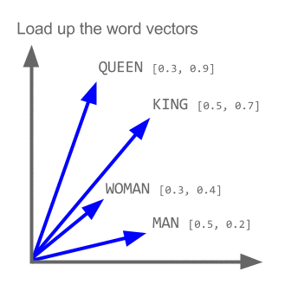
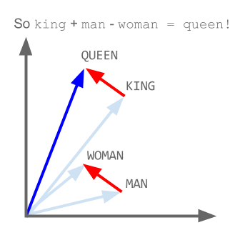
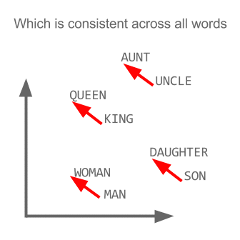
Word2Vec
北师大系统科学学院：面向复杂系统的人工智能，2024

Slide 24


Generative AI
北师大系统科学学院：面向复杂系统的人工智能，2024

Slide 25
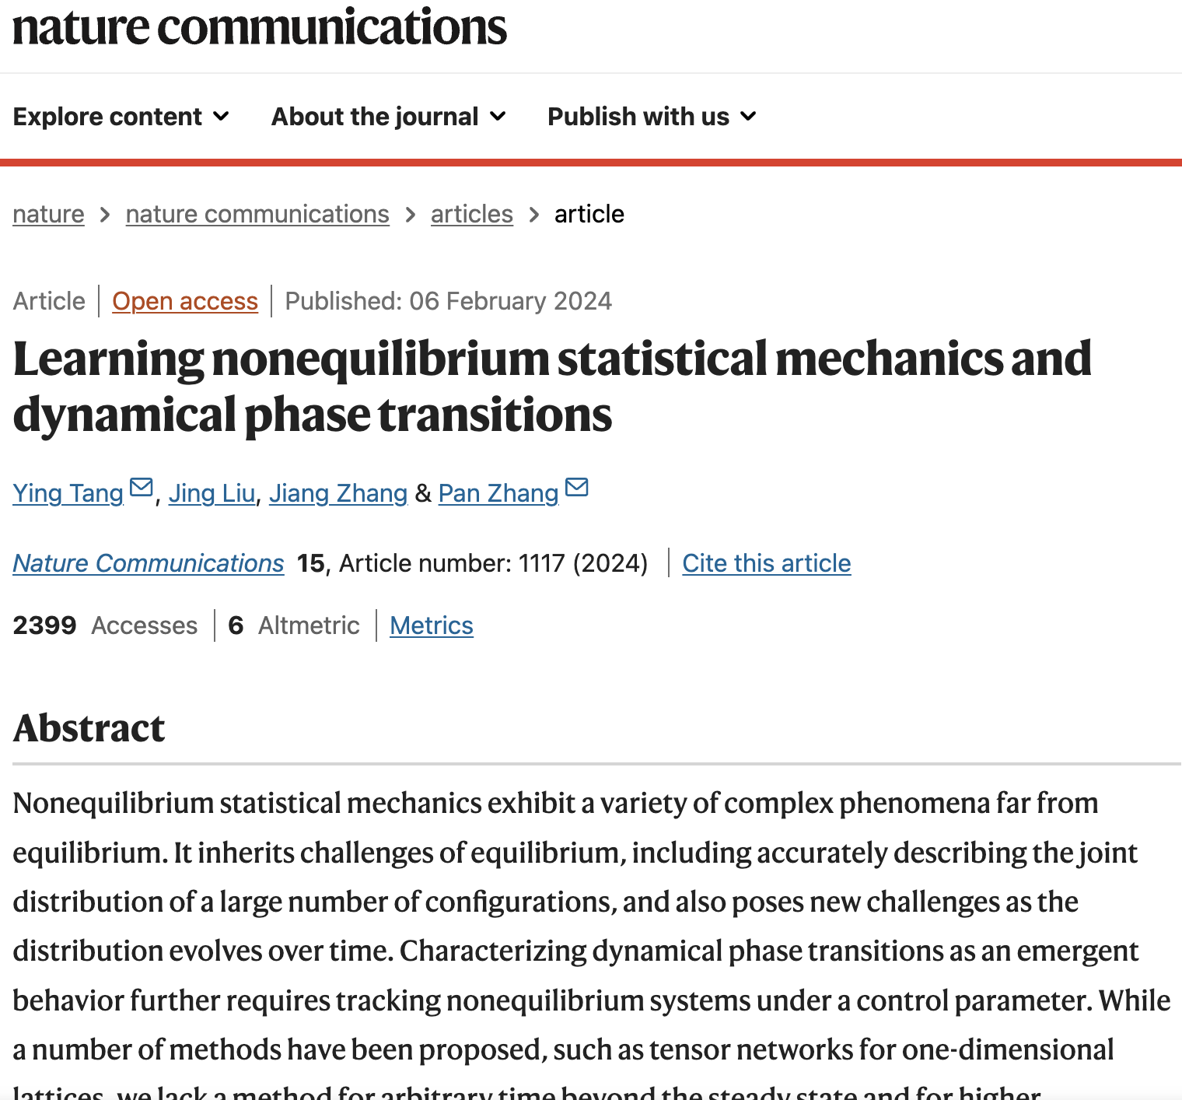
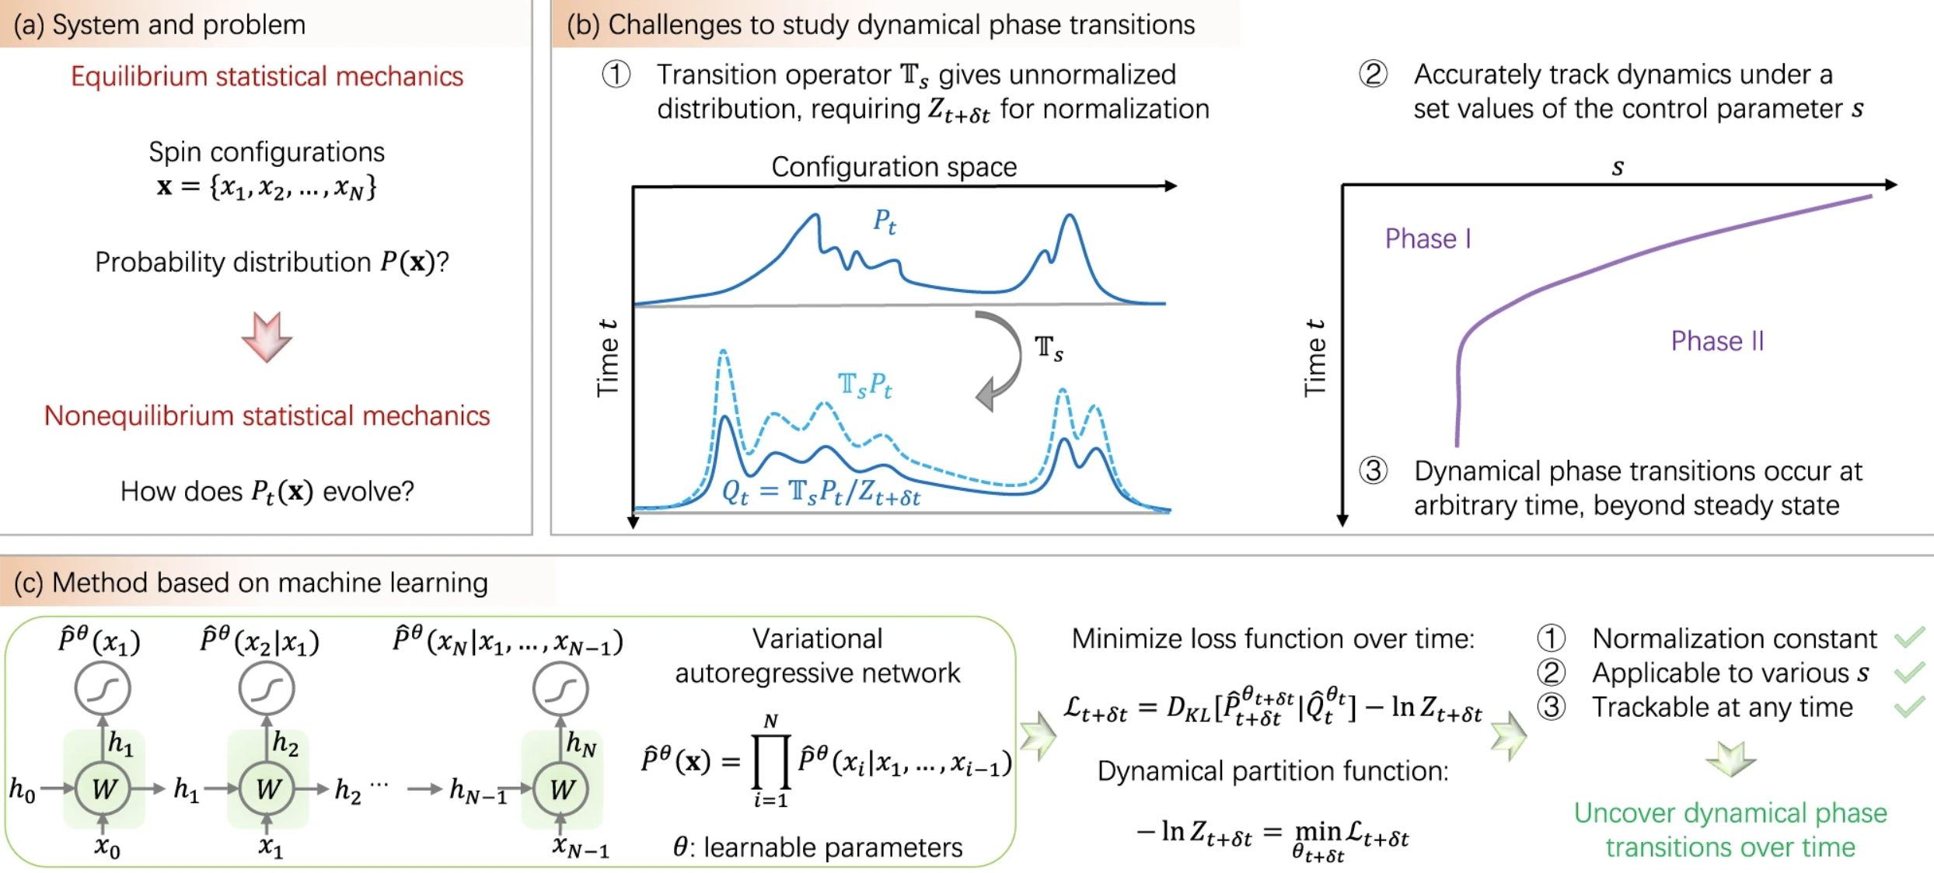
Learning nonequilibrium statistical mechanics and dynamical phase transitions
https://www.nature.com/articles/s41467-024-45172-8

Slide 26
Outline
AI for complex systems
Complex Systems and Modelling Methods
Representation & Generation
Dynamics Learning
Network Reconstruction
Multi-scale Modelling
Simulation, optimization, and control
Complexity science for AI
北师大系统科学学院：面向复杂系统的人工智能，2024

Slide 27
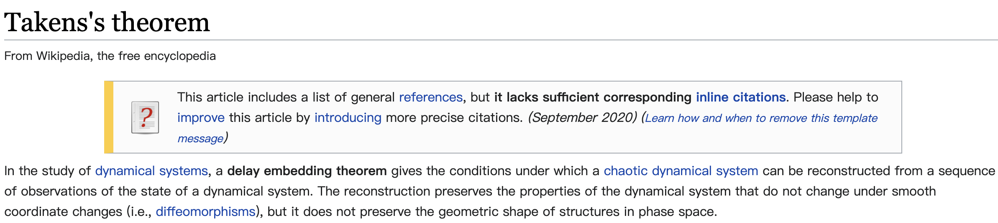
Problem Definition
Behavior (observations)
AI systems
Models
Predict Next Time Step
Abstractor reconstruction
Polynomial regression
Compressed sensing
Driving response
Reservoir Computing
Time series analysis…
https://en.wikipedia.org/wiki/Takens's_theorem

Slide 28
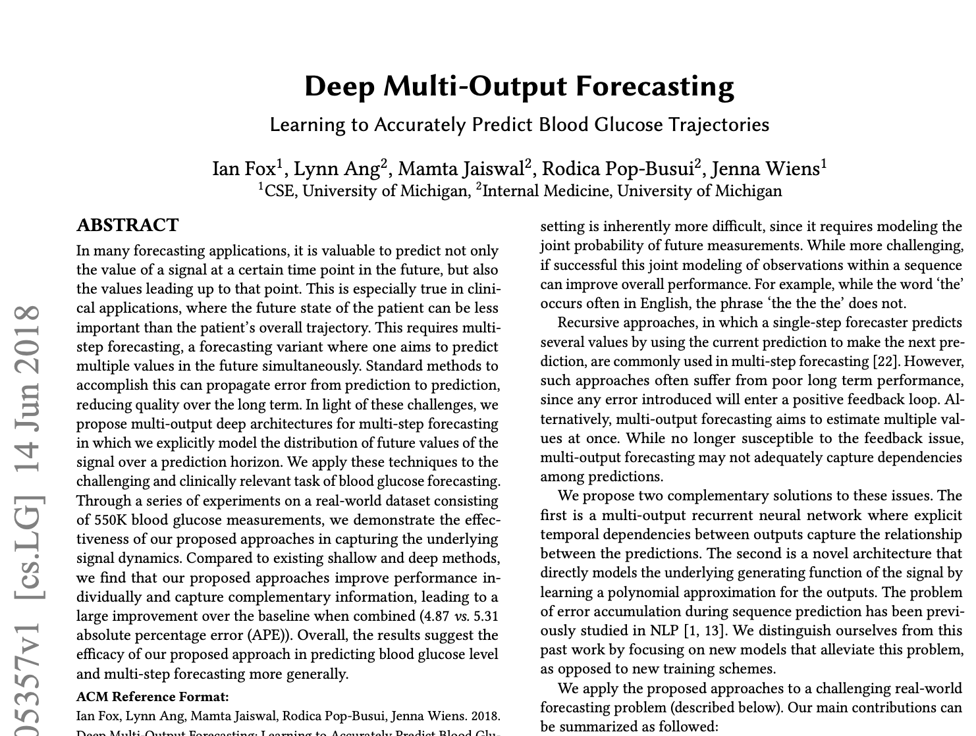
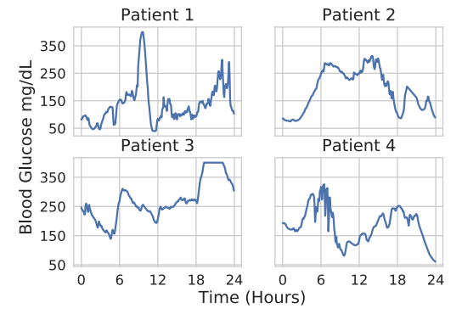
RNN based Dynamics Learning
Ian Fox, Lynn Ang, Mamta Jaiswal, Rodica Pop-Busui, and Jenna Wiens. Deep multi-output forecasting: Learning to accurately predict blood glucose trajectories. In Proceedings of the 24th ACM SIGKDD International Conference on Knowledge Discovery & Data Mining, pages 1387–1395. ACM, 2018.

Slide 29
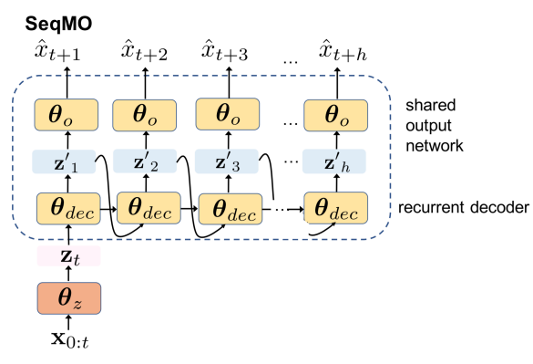
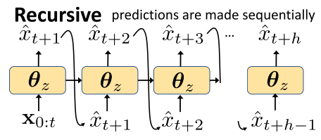
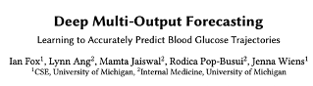
Recursive v.s. Multi-output
Forecasting with DeepMO involves transforming the input to a shared representation and then learning separate output networks for each time point in the prediction horizon h.
Ian Fox, Lynn Ang, Mamta Jaiswal, Rodica Pop-Busui, and Jenna Wiens. Deep multi-output forecasting: Learning to accurately predict blood glucose trajectories. In Proceedings of the 24th ACM SIGKDD International Conference on Knowledge Discovery & Data Mining, pages 1387–1395. ACM, 2018.

Slide 30
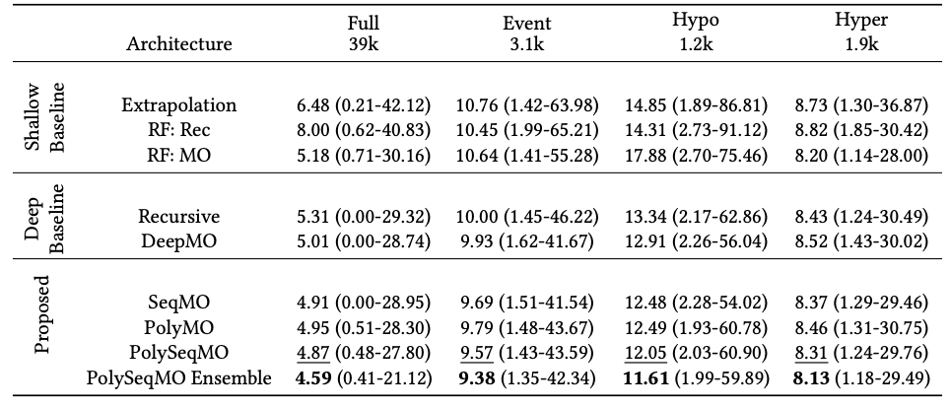
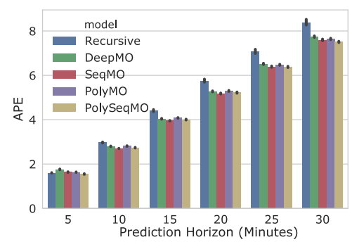
Results
Ian Fox, Lynn Ang, Mamta Jaiswal, Rodica Pop-Busui, and Jenna Wiens. Deep multi-output forecasting: Learning to accurately predict blood glucose trajectories. In Proceedings of the 24th ACM SIGKDD International Conference on Knowledge Discovery & Data Mining, pages 1387–1395. ACM, 2018.

Slide 31
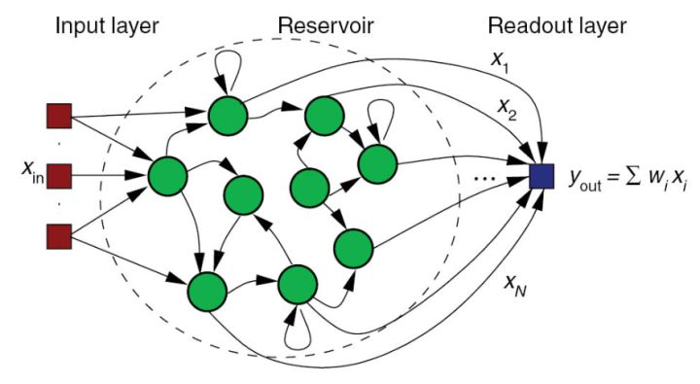
Reservoir Computing
https://en.wikipedia.org/wiki/Reservoir_computing

Slide 32
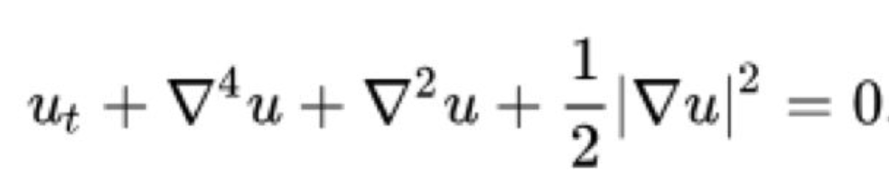

Kuramoto-Sivashinsky equation:
Predict Chaotic Dynamics
Phys. Rev. Lett. 120, 024102

Slide 33
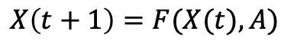
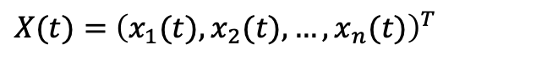
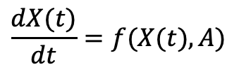
Dynamics on Graph
$$\frac{dX(t)}{dt}=f(X(t),A)$$
$X(t)=$ ${\left(x_{1}(t),x_{2}(t),…, x_{n}(t)\right)}^{T}$
$$X\left(t+1\right)=F(X(t),A)$$
北师大系统科学学院：面向复杂系统的人工智能，2024

Slide 34
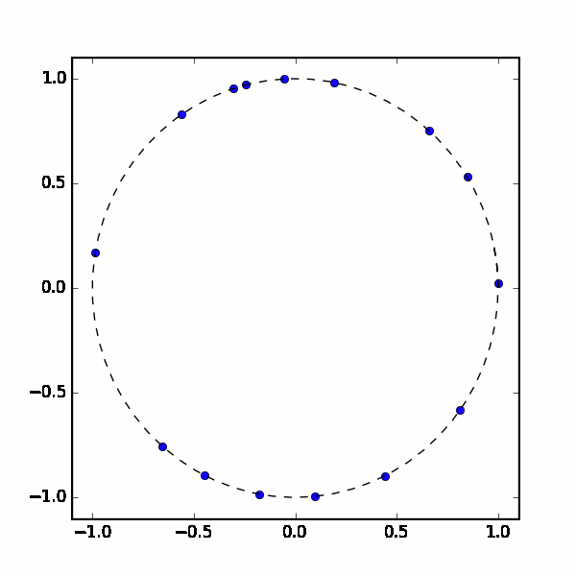
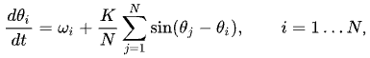
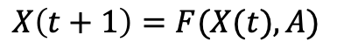
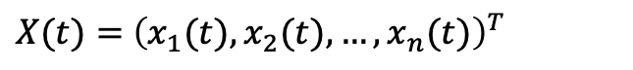
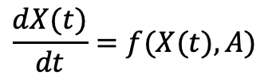
Dynamics on Graph
$$\frac{dX(t)}{dt}=f(X(t),A)$$
$X(t)=$ ${\left(x_{1}(t),x_{2}(t),…, x_{n}(t)\right)}^{T}$
$$X\left(t+1\right)=F(X(t),A)$$
北师大系统科学学院：面向复杂系统的人工智能，2024

Slide 35
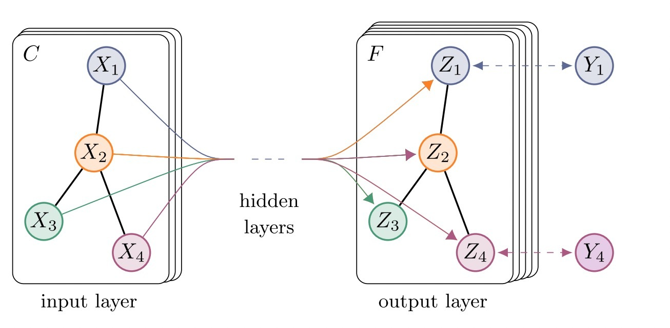
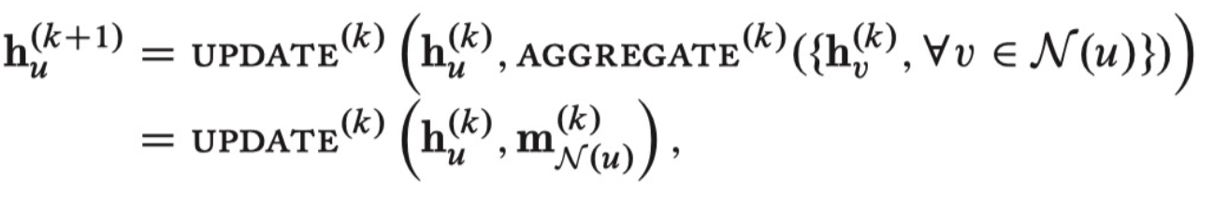
Learning on Graph
北师大系统科学学院：面向复杂系统的人工智能，2024

Slide 36
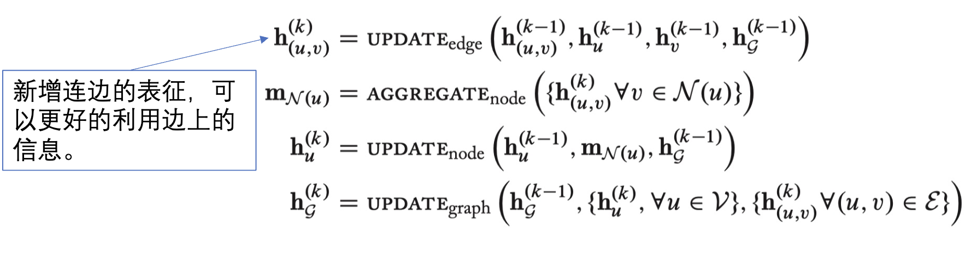
Extended Graph Neural Network
北师大系统科学学院：面向复杂系统的人工智能，2024

Slide 37
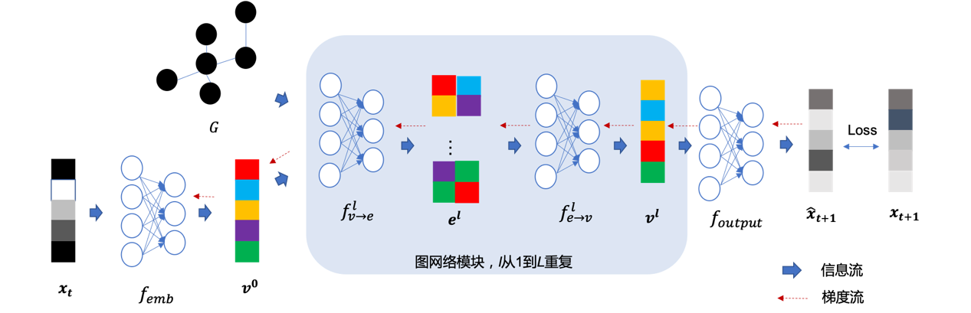
Dynamics Learning on Graph
北师大系统科学学院：面向复杂系统的人工智能，2024

Slide 38
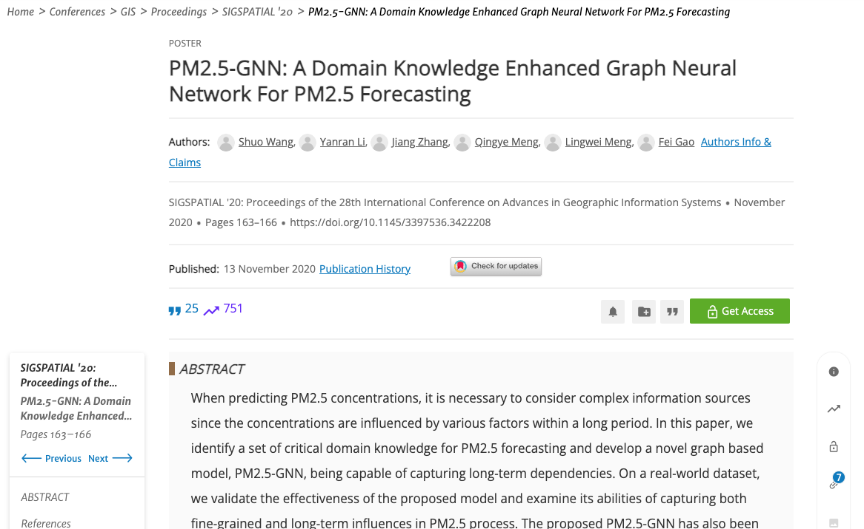
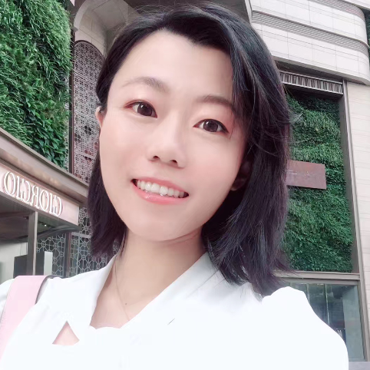
PM2.5 Forecasting
王硕
李嫣然
Shuo Wang, Yanran Li, Jiang Zhang, Qingye Meng, Lingwei Meng, and Fei Gao. 2020. PM2.5-GNN: A Domain Knowledge Enhanced Graph Neural Network For PM2.5 Forecasting. In Proceedings of the 28th International Conference on Advances in Geographic Information Systems (SIGSPATIAL '20). Association for Computing Machinery, New York, NY, USA, 163–166. https://doi.org/10.1145/3397536.3422208

Slide 39
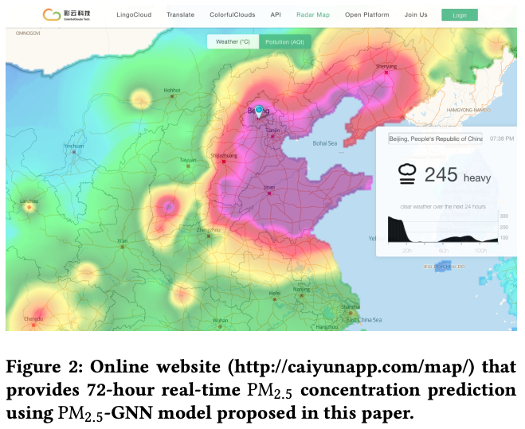
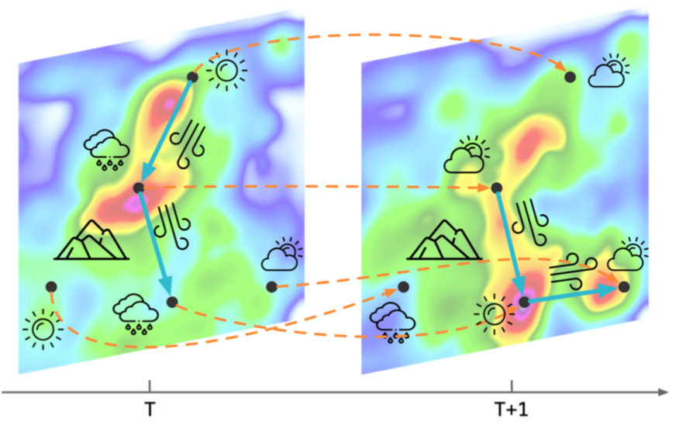
Tasks
Shuo Wang, Yanran Li, Jiang Zhang, Qingye Meng, Lingwei Meng, and Fei Gao. 2020. PM2.5-GNN: A Domain Knowledge Enhanced Graph Neural Network For PM2.5 Forecasting. In Proceedings of the 28th International Conference on Advances in Geographic Information Systems (SIGSPATIAL '20). Association for Computing Machinery, New York, NY, USA, 163–166. https://doi.org/10.1145/3397536.3422208

Slide 40
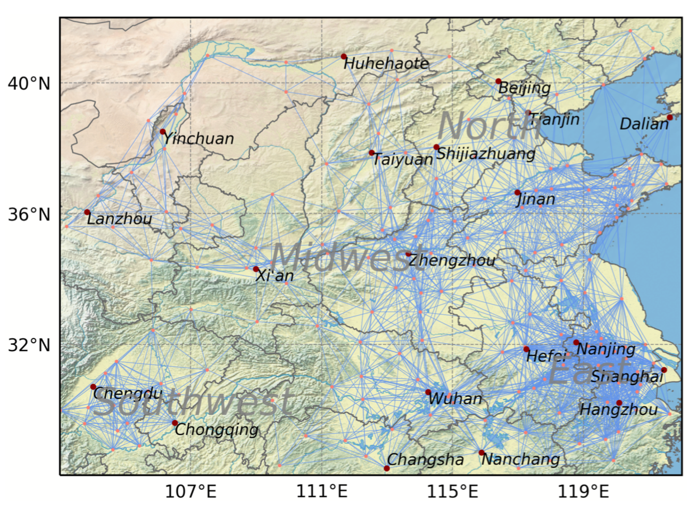
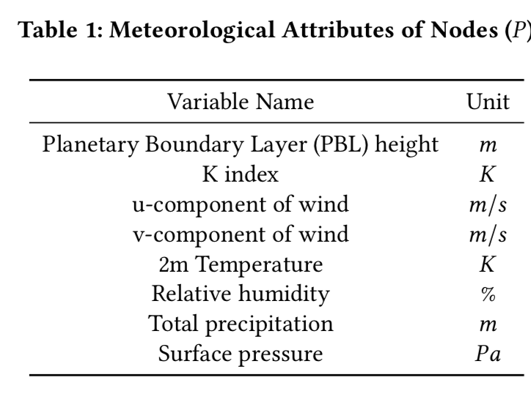
Input Attributes
Shuo Wang, Yanran Li, Jiang Zhang, Qingye Meng, Lingwei Meng, and Fei Gao. 2020. PM2.5-GNN: A Domain Knowledge Enhanced Graph Neural Network For PM2.5 Forecasting. In Proceedings of the 28th International Conference on Advances in Geographic Information Systems (SIGSPATIAL '20). Association for Computing Machinery, New York, NY, USA, 163–166. https://doi.org/10.1145/3397536.3422208

Slide 41
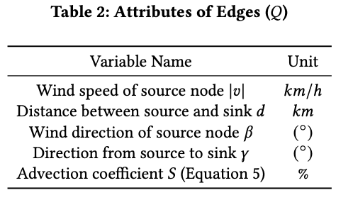
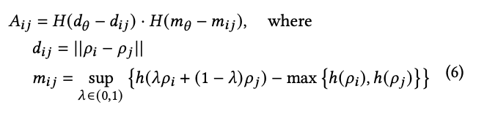




Network Constructing
$$ρ_{i}$$
$$d_{ij}$$
$$ρ_{j}$$
h
$$H\left(x\right)=\left\{\begin{matrix}1. if x>0 \\ 0. if x≤0\end{matrix}\right.$$
Shuo Wang, Yanran Li, Jiang Zhang, Qingye Meng, Lingwei Meng, and Fei Gao. 2020. PM2.5-GNN: A Domain Knowledge Enhanced Graph Neural Network For PM2.5 Forecasting. In Proceedings of the 28th International Conference on Advances in Geographic Information Systems (SIGSPATIAL '20). Association for Computing Machinery, New York, NY, USA, 163–166. https://doi.org/10.1145/3397536.3422208

Slide 42





Model
Shuo Wang, Yanran Li, Jiang Zhang, Qingye Meng, Lingwei Meng, and Fei Gao. 2020. PM2.5-GNN: A Domain Knowledge Enhanced Graph Neural Network For PM2.5 Forecasting. In Proceedings of the 28th International Conference on Advances in Geographic Information Systems (SIGSPATIAL '20). Association for Computing Machinery, New York, NY, USA, 163–166. https://doi.org/10.1145/3397536.3422208

Slide 43

Results – Time Series
Shuo Wang, Yanran Li, Jiang Zhang, Qingye Meng, Lingwei Meng, and Fei Gao. 2020. PM2.5-GNN: A Domain Knowledge Enhanced Graph Neural Network For PM2.5 Forecasting. In Proceedings of the 28th International Conference on Advances in Geographic Information Systems (SIGSPATIAL '20). Association for Computing Machinery, New York, NY, USA, 163–166. https://doi.org/10.1145/3397536.3422208

Slide 44




Results
Shuo Wang, Yanran Li, Jiang Zhang, Qingye Meng, Lingwei Meng, and Fei Gao. 2020. PM2.5-GNN: A Domain Knowledge Enhanced Graph Neural Network For PM2.5 Forecasting. In Proceedings of the 28th International Conference on Advances in Geographic Information Systems (SIGSPATIAL '20). Association for Computing Machinery, New York, NY, USA, 163–166. https://doi.org/10.1145/3397536.3422208

Slide 45

Ablation – Domain Knowledge
Shuo Wang, Yanran Li, Jiang Zhang, Qingye Meng, Lingwei Meng, and Fei Gao. 2020. PM2.5-GNN: A Domain Knowledge Enhanced Graph Neural Network For PM2.5 Forecasting. In Proceedings of the 28th International Conference on Advances in Geographic Information Systems (SIGSPATIAL '20). Association for Computing Machinery, New York, NY, USA, 163–166. https://doi.org/10.1145/3397536.3422208

Slide 46

Large Models
北师大系统科学学院：面向复杂系统的人工智能，2024

Slide 47

Large Models
北师大系统科学学院：面向复杂系统的人工智能，2024

Slide 48

Large Models
Ming Jin et al.: Large Models for Time Series and Spatio-Temporal Data: A Survey and Outlook, arXiv:2310.10196v2

Slide 49

Large Models
Ming Jin et al.: Large Models for Time Series and Spatio-Temporal Data: A Survey and Outlook, arXiv:2310.10196v2

Slide 50
Outline
AI for complex systems
Complex Systems and Modelling Methods
Representation & Generation
Dynamics Learning
Network Reconstruction
Multi-scale Modelling
Simulation, optimization, and control
Complexity science for AI
北师大系统科学学院：面向复杂系统的人工智能，2024

Slide 51

Network Reconstruction
Graph Neural Network
Inferred Network and Dynamics
北师大系统科学学院：面向复杂系统的人工智能，2024

Slide 52





Various Dynamics
$$x_{i}\left(t+1\right)=\left(1−s\right)h\left(x_{i}\left(t\right)\right)+\frac{s}{D}\sum_{j≠i}{h\left(x_{j}\left(t\right)\right)}$$
$$\frac{dφ_{i}}{dt}=ω_{i}+k\sum_{j≠i}{A_{ij}sin⁡ (φ_{i}−φ_{j})}$$
$$h\left(x\right)=λx(1−x)$$
https://journals.aps.org/pre/abstract/10.1103/PhysRevE.106.034315

Slide 53
Gumbel Graph Network
张章
赵诣
刘晶
王硕
陶如意
张江
Accepted by journal of applied network science
https://arxiv.org/abs/1812.11482v3

Slide 54


AIDD
张妍
https://journals.aps.org/pre/abstract/10.1103/PhysRevE.106.034315

Slide 55


Key Idea
Gumbel softmax trick
Idea from Granger Causality
https://journals.aps.org/pre/abstract/10.1103/PhysRevE.106.034315

Slide 56




Problem
Action 1
$$p_{θ}^{1}$$
A Differential Stochastic Machine with parameter
$$p_{θ}^{i}$$
$$p_{θ}^{2}$$
Action 2
Probility
Action 3
Action 4
$$p_{θ}^{5}$$
Action 5
Non differentiable
Eric Jang et al.: CATEGORICAL REPARAMETERIZATION WITH GUMBEL-SOFTMAX, ICRL 2017

Slide 57



Gumbel softmax
$$f\left(z\right)=f\left(y\right)$$
$$y=softmax\left(\log{P_{θ}\left(Y\right)}+g\right)=\frac{exp⁡(\frac{\log{{pθ}^{i}}+g^{i}}{τ})}{\sum_{i}{exp⁡(\frac{\log{{pθ}^{i}}+g^{i}}{τ})}}$$
$Z$ is a categorical variable (1,2,…,N) with probability
$$P_{θ}\left(Y\right)=\left({pθ}^{1},{pθ}^{2},…,{pθ}^{n}\right)$$
$g=\left(g^{1},g^{2},…,g^{n}\right)$ are iid for given distribution
gumbel distribution (0,1)
Eric Jang et al.: CATEGORICAL REPARAMETERIZATION WITH GUMBEL-SOFTMAX, ICRL 2017

Slide 58



Network Generator
$${\left(\frac{exp⁡(\frac{\log{{αij}^{}}+g_{ij}}{τ})}{\exp\left(\frac{\log{{αij}^{}}+g_{ij}}{τ}\right)+exp⁡\left(\frac{log(1−{{αij}^{}})+g_{ij}}{τ}\right)}\right)}_{N×N}$$
$$\left(\begin{matrix}α_{11} & ⋯ & α_{1N} \\ ⋮ & α_{ij} & ⋮ \\ α_{N1} & ⋯ & α_{NN}\end{matrix}\right)$$
$$\left(\begin{matrix}0 & ⋯ & 1 \\ ⋮ & a_{ij} & ⋮ \\ 0 & ⋯ & 1\end{matrix}\right)$$
https://journals.aps.org/pre/abstract/10.1103/PhysRevE.106.034315

Slide 59

Results – Centrality
Gu, W., Gao, F., Lou, X. et al. Discovering latent node Information by graph attention network. Scientific Reports 11, 6967 (2021).

Slide 60




ARNI(Algorithm for Revealing Network Interactions )
https://www.nature.com/articles/s41467-017-02288-4

Slide 61



NRI(Neural Relational Inference)
https://arxiv.org/abs/1802.04687

Slide 62

Comparisons
https://journals.aps.org/pre/abstract/10.1103/PhysRevE.106.034315

Slide 63

Gene Network Reconstruction
https://journals.aps.org/pre/abstract/10.1103/PhysRevE.106.034315

Slide 64


Missing Nodes
https://journals.aps.org/pre/abstract/10.1103/PhysRevE.106.034315

Slide 65



Missing Nodes
https://arxiv.org/pdf/2202.10144.pdf

Slide 66

Learning hidden interactions
北师大系统科学学院：面向复杂系统的人工智能，2024

Slide 67
Boid Model
Boid model
Each boid follows 3 rules
Cohesion
Alignment
Separation
北师大系统科学学院：面向复杂系统的人工智能，2024

Slide 68

Self-attention
https://www.nature.com/articles/s41598-021-91878-w

Slide 69


Self-attention visualization
北师大系统科学学院：面向复杂系统的人工智能，2024
Notes:
Result of AgentNet for cellular automata. (A) Attention weight transition of a single target cell throughout the training. In the initial stage, the model has no information about interaction range and assigns nearly similar values to all of the cells in the system. Attention gets narrowed down to a smaller region as training advances, and finally concentrates into eight surrounding cells, which is the theoretical interaction range. (B), (C) AgentNet predictions with respect to given alive and dead microstates, respectively. The total number of alive cells in the neighborhood is denoted by s, which is the sole parameter of the CA decision rule.

Slide 70
Outline
AI for complex systems
Complex Systems and Modelling Methods
Representation & Generation
Dynamics Learning
Network Reconstruction
Multi-scale Modelling
Simulation, optimization, and control
Complexity science for AI
北师大系统科学学院：面向复杂系统的人工智能，2024

Slide 71




Multi-scale Modelling
Coarse Graining
Coarse Graining
Automated Modelling
Automated Modelling
Automated Modelling
$$\frac{dX_{S}}{dt}=f_{S}(X_{S})$$
$$\frac{dX_{M}}{dt}=f_{M}(X_{M})$$
$$\frac{dX_{L}}{dt}=f_{L}(X_{L})$$
北师大系统科学学院：面向复杂系统的人工智能，2024

Slide 72


Station - City
https://arxiv.org/abs/2101.04264v1

Slide 73



Skeleton-based action recognition
https://arxiv.org/abs/2206.13028

Slide 74

Graph U-Net
https://arxiv.org/abs/1905.05178

Slide 75

U-Net
https://arxiv.org/abs/1505.04597

Slide 76

How to Down Sampling a Graph?
https://arxiv.org/abs/1905.05178

Slide 77


How to Down Sampling a Graph?
https://arxiv.org/abs/1905.05178

Slide 78
Whole Picture
https://arxiv.org/abs/1905.05178

Slide 79



Learning More Effective Dynamics on Macro-scale
https://journals.aps.org/prl/abstract/10.1103/PhysRevLett.124.010508

Slide 80


Learning More Effective Dynamics on Macro-scale
https://arxiv.org/abs/2112.10755

Slide 81


Learning More Effective Dynamics on Macro-scale
https://arxiv.org/abs/2112.10755

Slide 82



Learning More Effective Dynamics on Macro-scale
https://www.nature.com/articles/s42256-022-00464-w

Slide 83


World Models
https://arxiv.org/pdf/1803.10122.pdf

Slide 84


World Models
https://arxiv.org/pdf/1803.10122.pdf

Slide 85


World Models
https://arxiv.org/pdf/1803.10122.pdf

Slide 86

Dreamers
https://arxiv.org/pdf/1912.01603.pdf

Slide 87


Yann Lecun’s world model
https://openreview.net/pdf?id=BZ5a1r-kVsf

Slide 88


Neural Information Squeezer
$$\max_{ψ,g,M}{EI(g)}$$
s.t. $\left\|{ψ_{α}}^{−1}\left[g_{β}\left(χ\left(ψ_{α}\left(X_{t}\right)\right)\right),ξ_{t}\right]−X_{t+1}\right\|<ε$
https://arxiv.org/abs/2201.10154

Slide 89

Neural Information Squeezer +
Yang et al. Finding emergence in data by maximizing effective information

Slide 90
Outline
AI for complex systems
Complex Systems and Modelling Methods
Representation & Generation
Dynamics Learning
Network Reconstruction
Multi-scale Modelling
Simulation, optimization, and control
Complexity science for AI
北师大系统科学学院：面向复杂系统的人工智能，2024

Slide 91
Automated Modelling of Complex Systems
Complex System
Behavior (observations)
AI systems
Models
Prediction, Simulation, Optimization, Controls
北师大系统科学学院：面向复杂系统的人工智能，2024

Slide 92


Surrogate Model - DeepRSM
[1] Xing J, Zheng S, Ding D, et al. Deep learning for prediction of the air quality response to emission changes[J]. Environmental Science & Technology, 2020.
[2] Cohen A J, Brauer M, Burnett R, et al. Estimates and 25-year trends of the global burden of disease attributable to ambient air pollution: an analysis of data from the Global Burden of Diseases Study 2015[J]. The Lancet, 2017, 389(10082): 1907-1918.

Slide 93


Learning to Simulate Complex Physics with Graph Networks
https://arxiv.org/abs/2002.09405

Slide 94

Influence maximization problem
Finding the most significant node such that the influence could be maximized under the constraints of resource
北师大系统科学学院：面向复杂系统的人工智能，2024

Slide 95



Deep reinforcement learning
https://www.nature.com/articles/s42256-020-0177-2

Slide 96


Data driven control for complex networks
https://www.nature.com/articles/s41467-021-21554-0/figures/1

Slide 97


Controlling complex networks review
https://web.cs.ucdavis.edu/~raissa/Classes/253-S23/NRP_2023.pdf

Slide 98
AIDD
张妍
https://journals.aps.org/pre/abstract/10.1103/PhysRevE.106.034315

Slide 99


Automated Modelling of Complex Systems
Control law
Learned
Control law
Real
https://journals.aps.org/pre/abstract/10.1103/PhysRevE.106.034315

Slide 100

Automated Modelling of Complex Systems
https://journals.aps.org/pre/abstract/10.1103/PhysRevE.106.034315

Slide 101





Slide 102
Ladder of Causality
Judea Pearl: The Book of Why

Slide 103
Summary
Learning Complex Dynamics
Learning Dynamics on Networks
Learning Interaction Networks (Unsupervised)
Learning Multi-scale Dynamics
Applications of Surrogate Model
北师大系统科学学院：面向复杂系统的人工智能，2024

Slide 104


Retrieving knowledge from large models
https://arxiv.org/pdf/2104.08696.pdf

Slide 105

Neural network attributions
https://arxiv.org/pdf/1902.02302.pdf

Slide 106

General Large models
https://arxiv.org/pdf/2206.06336.pdf

Slide 107
Outline
AI for complex systems
Complexity science for AI
北师大系统科学学院：面向复杂系统的人工智能，2024

Slide 108



Scaling laws
北师大系统科学学院：面向复杂系统的人工智能，2024

Slide 109




Scaling Laws in LLM
https://arxiv.org/pdf/2001.08361.pdf

Slide 110


Independent with structures
https://arxiv.org/pdf/2001.08361.pdf

Slide 111

Independent with training data
https://arxiv.org/pdf/2001.08361.pdf

Slide 112







L: test loss
D: size of training data in tokens
N: # of parameters(non-embedding)
B: optimal batch size
C ≈ 6NBS : an estimate of the total non-embedding training compute
C_{min}: optimally allocated compute budget
S: # of training steps
S_{min}: the minimum possible number of optimization steps
“Thermodynamics” of LLM
With C is given
https://arxiv.org/pdf/2001.08361.pdf

Slide 113




Optimal Allocation of the Compute Budget
https://arxiv.org/pdf/2001.08361.pdf
Notes:
L~Cm^(-0.05), Bc=L^(-1/0.21)
→Sm~Cm^0.03

Slide 114


Scaling laws of vision transformer
https://arxiv.org/pdf/2106.04560.pdf

Slide 115


Emergent abilities
https://www.jasonwei.net/blog/emergence 137 emergent abilities

Slide 116


In-context learning - 类比思维
https://www.jasonwei.net/blog/emergence 137 emergent abilities

Slide 117

Chain of thought
https://www.jasonwei.net/blog/emergence 137 emergent abilities

Slide 118

Critical Phase Transition
https://www.jasonwei.net/blog/emergence 137 emergent abilities

Slide 119



Knowledge Quanta
Ziming Liu, April 2023
in Swarma Club
https://arxiv.org/pdf/2001.08361.pdf

Slide 120

Scale is all you need
https://www.jasonwei.net/blog/emergence 137 emergent abilities

Slide 121



Large Models & CAS
https://pattern.swarma.org/study_group_issue/412

Slide 122


Neural networks as complex networks
https://pattern.swarma.org/paper/6ea7ac84-2b29-11ea-a1e5-0242ac1a0007

Slide 123



Training dynamics and diffusion dynamics
openreview.net/pdf?id=wXgk_iCiYGo

Slide 124


Neural network and renormalization group
https://arxiv.org/pdf/1410.3831.pdf

Slide 125


Neural network and renormalization group
https://arxiv.org/pdf/1301.3124.pdf

Slide 126


Neural network renormalization group
https://arxiv.org/pdf/1802.02840.pdf

Slide 127

Splendid future
AI for complex systems
Automated modelling
Optimization
Control
…
Complexity science for AI
Scaling laws
Emergence
Renormalization & statistical physics
Complex networks
…
北师大系统科学学院：面向复杂系统的人工智能，2024

Slide 128
成绩
10%平时
60%分组项目
3-5人一组
题目统一提供
选题需商议，否则成绩无效
30%撰写集智百科词条
选题需商议，否则成绩无效
北师大系统科学学院：面向复杂系统的人工智能，2024

